Slide 1




NEXT GEN EMPLOYABILITY PROGRAM
Creating a future-ready workforce
Team Members
College Name
Student Name :Ajay avibhas R
Student ID :au814721104003
SRM TRP ENGINEERING COLLEGE

Slide 2

CAPSTONE PROJECT SHOWCASE
Project Title
Notes Sharing Web Application using Django Framework
Abstract | Problem Statement | Project Overview | Proposed Solution | Technology Used | Modelling & Results | Conclusion

Slide 3
Abstract
This project aims to develop a web application for sharing notes, built on the Django framework. The application will provide a platform where users can create, upload, view, and share notes with others. Users will be able to register for an account, log in securely, and manage their notes within the platform.
Additionally, the application will prioritize security measures to protect user data and ensure privacy. This includes implementing secure user authentication mechanisms, data encryption, and permission management to control access to notes.
Overall, the Notes Sharing Web Application will provide a convenient and secure platform for users to collaborate, exchange knowledge, and manage their notes effectively.

Slide 4
Problem Statement
In today's fast-paced digital environment, individuals often encounter challenges when it comes to managing and sharing notes effectively. Whether it's students collaborating on group projects, professionals sharing insights from meetings, or hobbyists exchanging information, there's a need for a centralized platform that simplifies the process of note creation, organization, and sharing.
Lack of Centralization: Users face difficulties in finding a single platform that offers all the necessary features for creating, organizing, and sharing notes efficiently.
Inadequate Security: Existing solutions may lack sufficient security measures to protect user data, leading to concerns about privacy and confidentiality

Slide 5
Project Overview
In the realm of note-taking and sharing, users encounter several challenges that impede their productivity and collaboration efforts. These challenges include:
Fragmented Tools: Users often resort to using multiple applications or tools for note-taking, organization, and sharing. This fragmentation can lead to inefficiencies, as users must navigate between different platforms, each with its own interface and features.
Security Concerns: Many existing note-sharing platforms may lack robust security measures, leaving user data vulnerable to breaches or unauthorized access. Without proper encryption and authentication mechanisms, users may hesitate to share sensitive information via these platforms.

Slide 6
Proposed Solution
.
The Notes Sharing Web Application built on the Django framework offers a robust solution to the challenges encountered in note-taking, organization, and sharing. Here's how the application addresses each problem:
Centralized Platform:
The application provides a unified platform where users can perform all note-related tasks, including creation, editing, organization, and sharing. This eliminates the need for users to switch between multiple tools or platforms.
Security Measures:
Robust security measures are implemented to ensure the safety and privacy of user data. This includes encryption of sensitive information, secure authentication mechanisms (such as OAuth or JWT), and role-based access control to manage user permissions.

Slide 7


Technology Used
Front-end
Back-end
Source :

Slide 8
MODELLING AND RESULTS
Modeling:
Database Modeling:
The application's data model is designed using Django's built-in ORM (Object-Relational Mapping) to define the structure of the database tables.
Search and Organization:
A powerful search functionality allows users to search for notes based on keywords, titles, categories, tags, or other criteria.
Results:
The Notes Sharing Web Application built on the Django framework provides users with a centralized platform for creating, organizing, and sharing notes efficiently.Users can collaborate seamlessly on notes, track changes, and communicate with collaborators in real-time

Slide 9
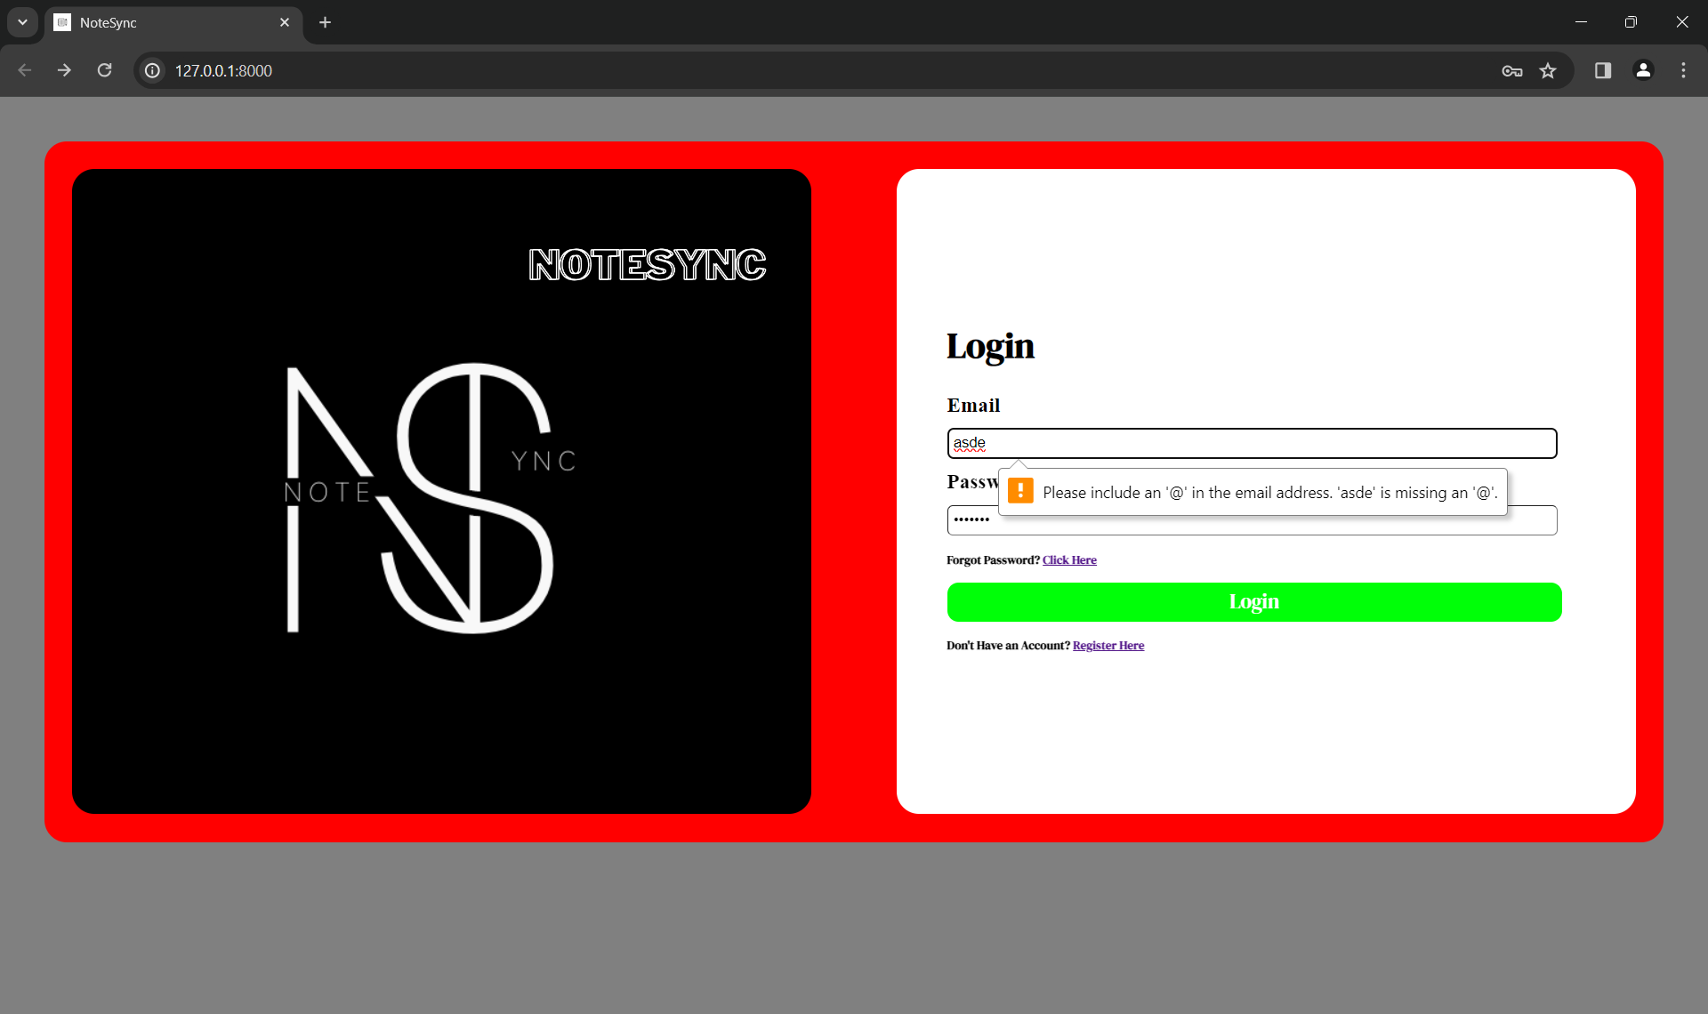
login_-page

Slide 10
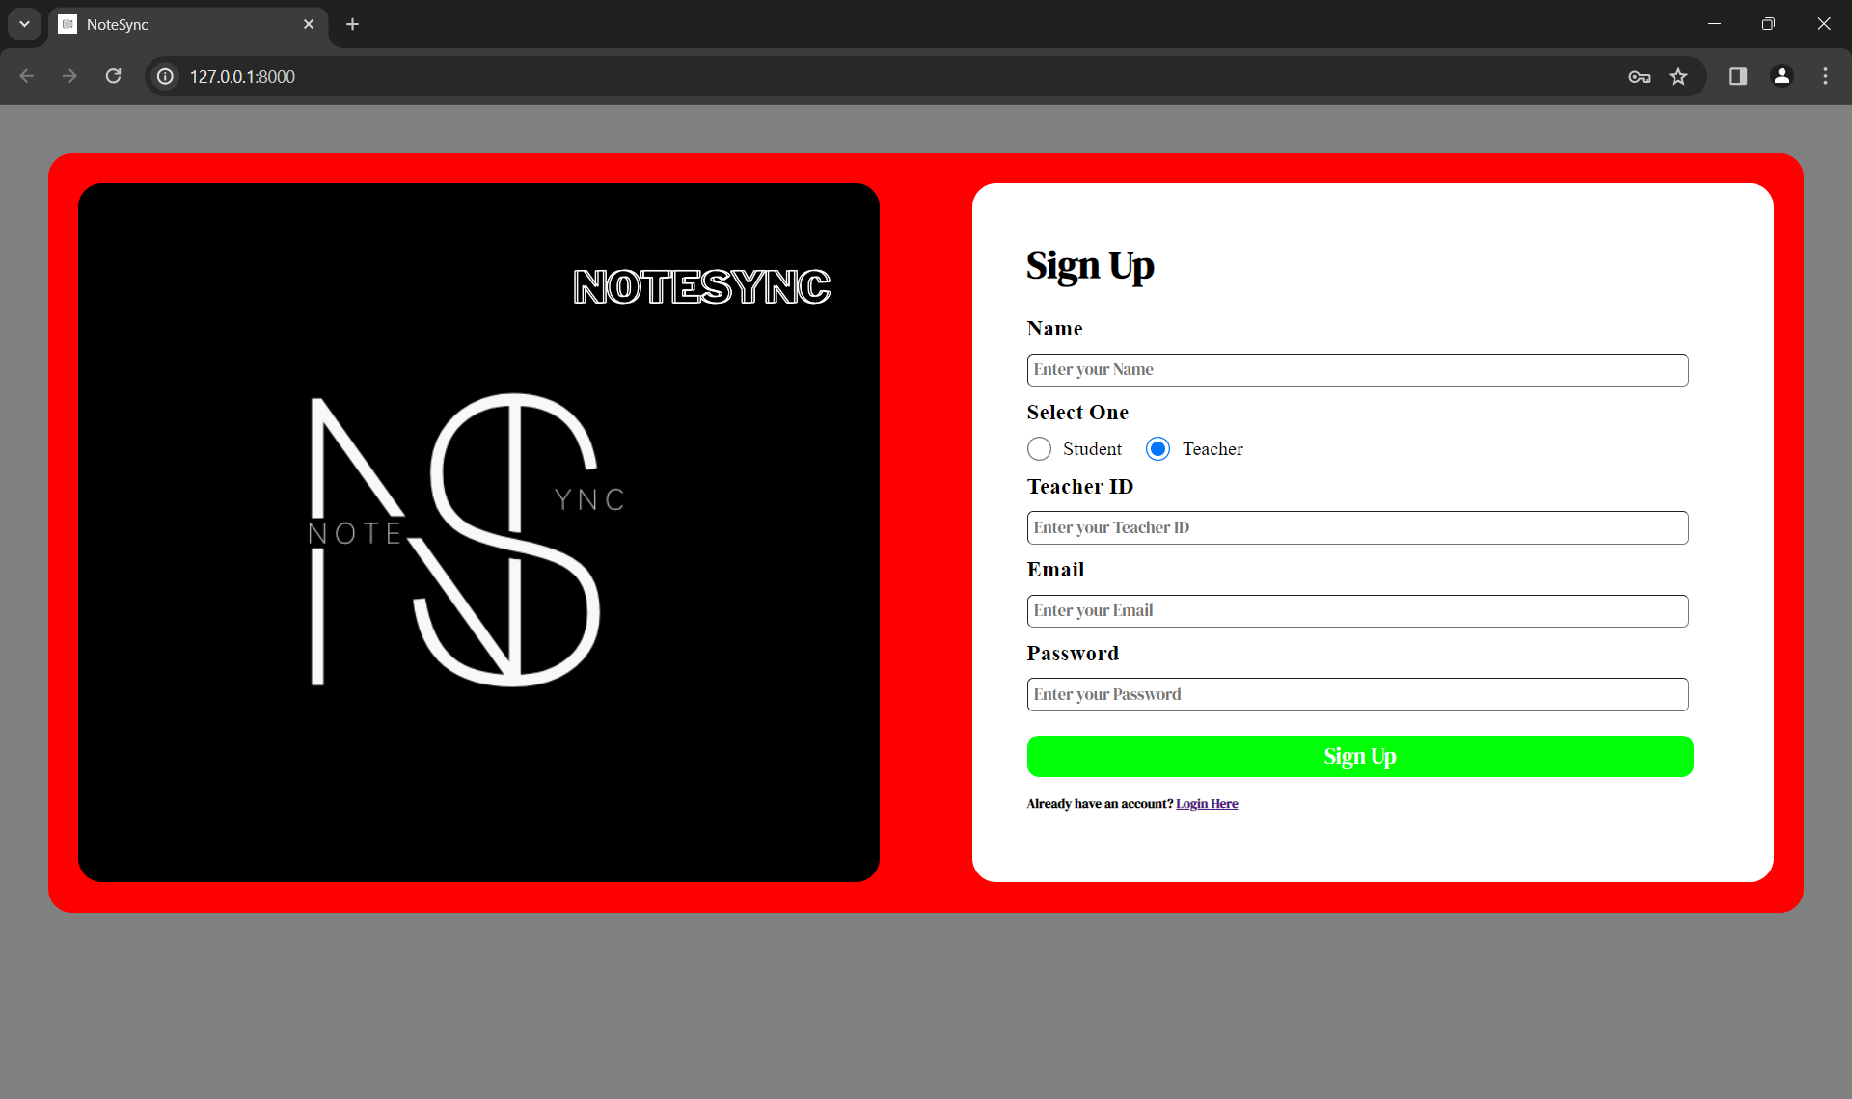
Student-signuo

Slide 11
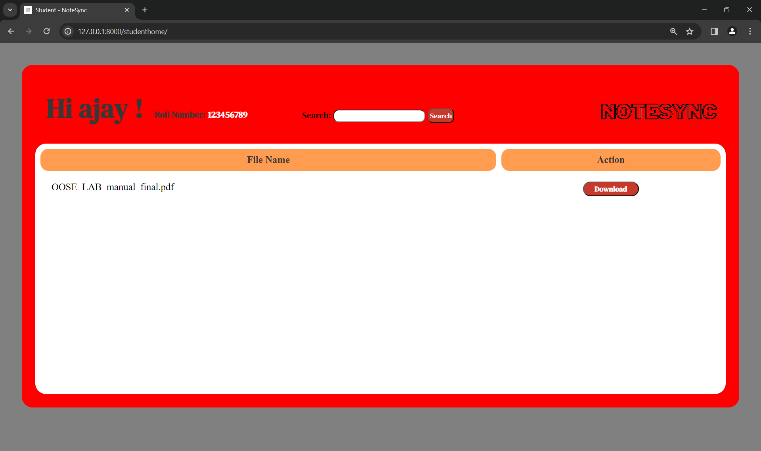
Student-page

Slide 12


signup

Slide 13
student-login

Slide 14
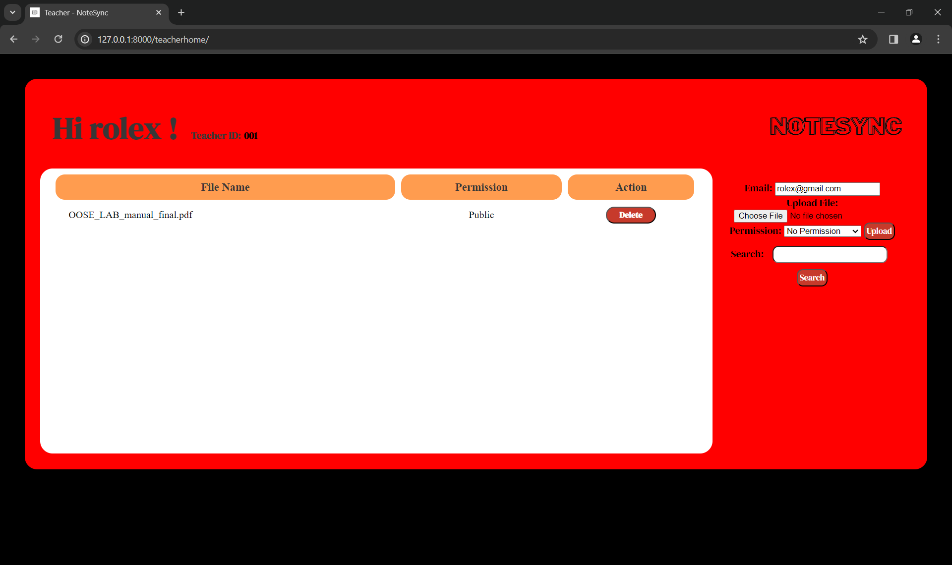
Teacher-page

Slide 15
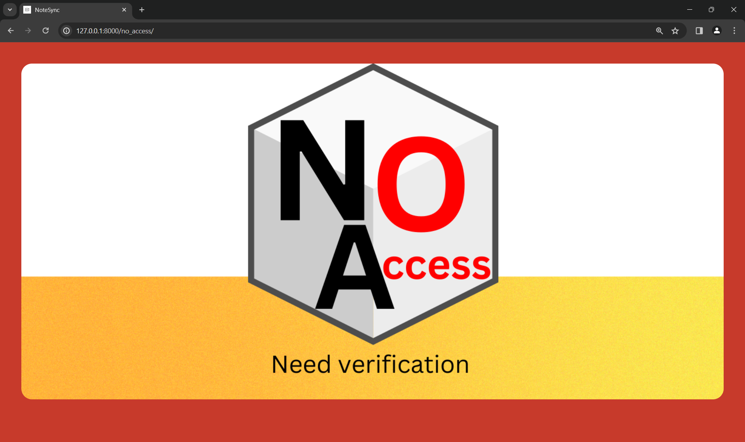
No-access

Slide 16
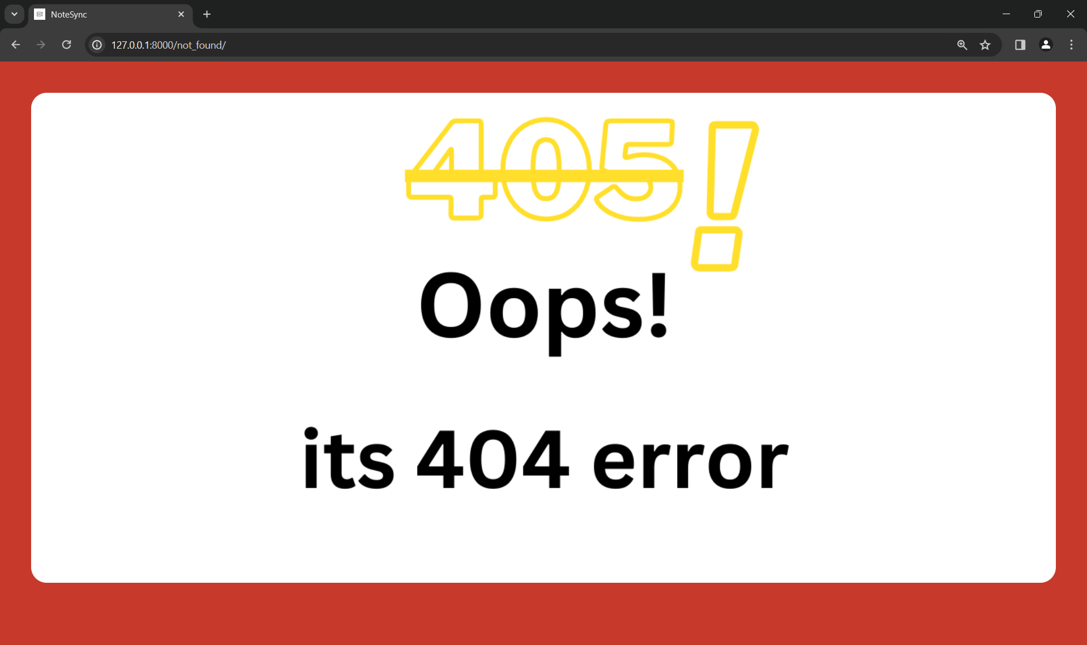
404-error

Slide 17
Future Enhancements:
Advanced Collaboration Features
Integration with External Tools
Enhanced Security Measures
Mobile Application Support
Offline Access and Synchronization
Customizable Templates and Workflows
Analytics and Insights
Accessibility Features
Community and User Feedback Integration

Slide 18
Conclusion
The Notes Sharing Web Application developed on the Django framework presents a comprehensive solution to the challenges encountered in note-taking, organization, and sharing. By providing a centralized platform with robust security measures, advanced collaboration features, efficient organization tools, and a user-friendly interface, the application aims to streamline workflows, enhance productivity, and facilitate seamless knowledge sharing among users.
Overall, the Notes Sharing Web Application serves as a valuable tool for individuals, teams, and organizations seeking to streamline their note-taking processes, collaborate effectively, and harness the power of shared knowledge. Through continuous refinement and innovation, the application will continue to evolve and remain a vital asset for users in their quest for productivity and collaboration excellence.
Source :

Slide 19
Thank You!
Notes:
Thank You !!

